Slide 1
Fisher Information Matrix
And Cramer-Rao Lower Bound

Slide 2
The Core Intuition
If we have a model with a parameter $θ$, how "sensitive" is our data to changes in $θ$?
High information corresponds to a "peaked" likelihood function, while low information corresponds to a "flat" one

Slide 3



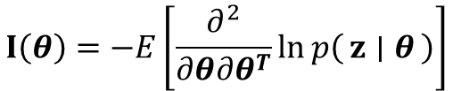
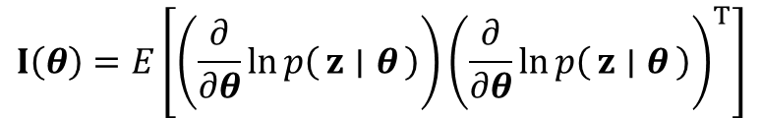

Definition
Let the parameter vector be:
We want to estimate an unknown quantity (parameter):
$$θ∈R^{n}$$
Given likelihood:
$$p\left(z ∣ θ\right)$$
The likelihood says: “If $θ$were true, how probable is the data?”
Take the derivative of the log-likelihood:
$$s\left(θ\right)=∇_{θ} ℓ\left(θ\right)=∇_{θ}\ln{p\left(z ∣ θ\right)}$$
Intuition: If a tiny change in $θ$causes a big change in $ℓ$, then the data is informative.
Fisher Information Matrix is the expected outer product of the score
$$I\left(θ\right)=E\left[s\left(θ\right)s{\left(θ\right)}^{T}\right]$$
$$I\left(θ\right)=E\left[\left(\frac{∂}{∂θ}\ln{p\left(z ∣ θ\right)}\right){\left(\frac{∂}{∂θ}\ln{p\left(z ∣ θ\right)}\right)}^{T}\right]$$
The Fisher Information Matrix (FIM) is defined as:
A common alternative form uses the second derivative (curvature):
$$I\left(θ\right)=−E\left[\frac{∂^{2}}{∂θ∂θ^{T}}\ln{p\left(z ∣ θ\right)}\right]$$

Slide 4

Cramér–Rao Lower Bound
No unbiased estimator can have covariance smaller than:
$$\text{Cov}\left(\hat{θ}\right)≽I{\left(θ\right)}^{−1}$$

Slide 5

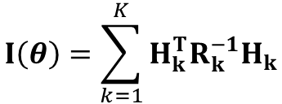

Gaussian Noise
Assume measurements are model + noise:
$$z=h\left(θ\right)+v, v∼𝒩\left(0,R\right)$$
$$H=\frac{∂h\left(θ\right)}{∂θ}$$
Define the Jacobian (how the measurement changes with the parameter)
For the Gaussian model, Fisher information becomes
$$I\left(θ\right)=H^{T}R^{−1}H$$
$$I\left(θ\right)=\sum_{k=1}^{K}{H_{k}^{T}R_{k}^{−1}H_{k}}$$
Independent measurements add information
Intuition: More measurements (or better ones) → more information.

Slide 6


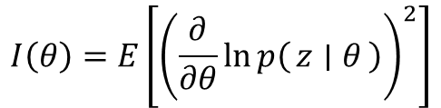
Uncertainty ellipsoid
CRLB says uncertainty is bounded by
$$P_{min}=I{\left(θ\right)}^{−1}$$
$$I\left(θ\right)=E\left[{\left(\frac{∂}{∂θ}\ln{p\left(z ∣ θ\right)}\right)}^{2}\right]$$
If $θ$is one number,
$$\text{Var}\left(\hat{θ}\right)≥\frac{1}{I\left(θ\right)}$$
And CRLB becomes

Slide 7
Fisher information of popular distributions

